Slide 1
Falls Update
CNO-May 9th,

Slide 2
Falls/Safe Patient Handling Fairs
January 27th, 28th, 29th in B Entrance
February 27th-South Clinical Campus
Stations:
Review of Hendrich II/Documenting falls/ patient falls agreement/Q & A
Bed and chair alarms
Body mechanics
Lift training
Using gait belts

Slide 3
Attendance: Grand Total 1040 participants

Slide 4
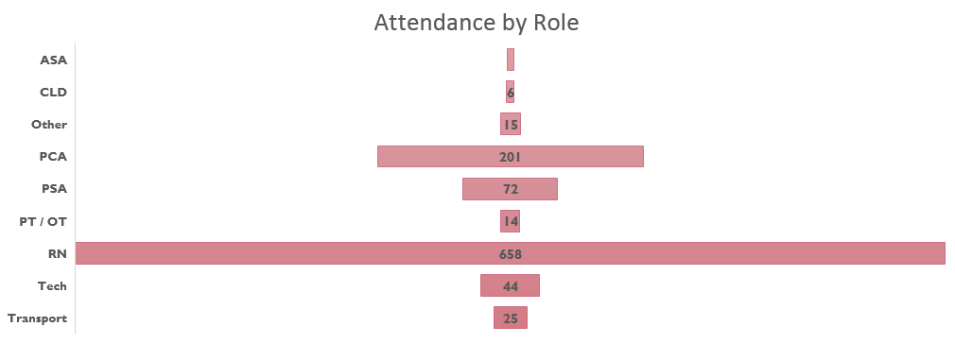
Fair Attendance by Role

Slide 5
Attendance by Unit

Slide 6
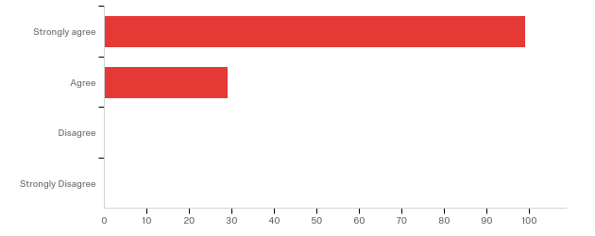
feedback
Q1 - The content presented was relevant to the stated objectives.

Slide 7
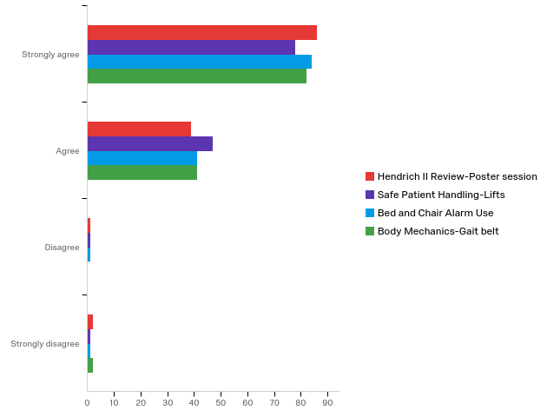
Feedback
(continued)
Q7 - The teaching was effective for this learning activity.

Slide 8
Issues Identified
Slings are hard to find
Not all units consistently stock chair alarm pads
Not all units have the cables to plug in beds and chair alarms into the walls
Not all units are using the patient agreement for falls
Some units do not do hourly rounds or bedside report

Slide 9

Should we still care About falls?

Slide 10
Falls ranked 3rd in all unintentional deaths in 2017
Centers for Disease Control and Prevention. (2019, May 8). Leading Causes of Death Reports. Retrieved from WISQUARS: https://webappa.cdc.gov/cgi-bin/broker.exe

Slide 11
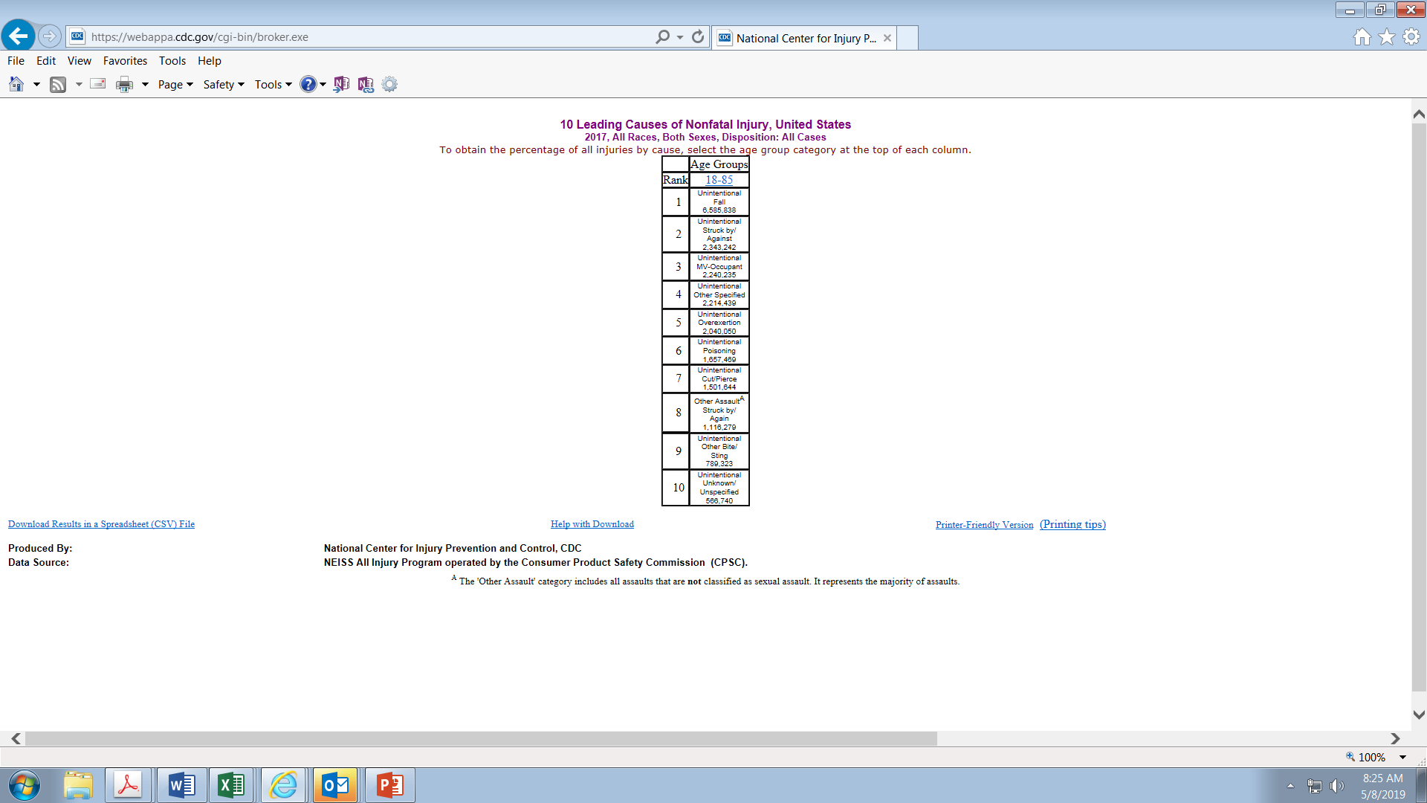
Falls Were the leading cause of non-fatal injury in the US in 2017
Centers for Disease Control and Prevention. (2019, May 8). 10 Leading Causes of Non-fatal Injury in the United States. Retrieved from https://webappa.cdc.gov/sasweb/ncipc/nfilead.html: 2019

Slide 12
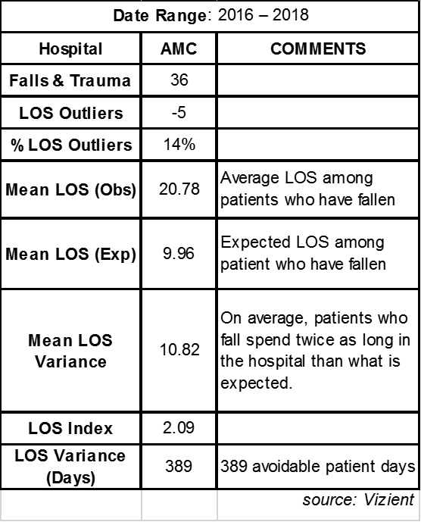
AMC Data
In 2018 there were 792 inpatient falls.
The number of high harm falls for 2018 (harm score 6 and above) was 53.
These injuries required treatment, elevation in level of care, and an increase in the amount of time patients have had to stay in the hospital.
According to Vizient, AMC is benchmarked at 64th/155 like institutions

Slide 13
2019 by the numbers-
68% Med-surg/Progressive Care
17% Special Populations ED/Psych/E8/BBSS
4% ICU
9 % W & C
1% procedural
1% peri-op

Slide 14
All Falls through April 2017, 2018,2019
14% reduction since 2017 in all nursing falls
22% reduction in
Med-Surg falls

Slide 15
Success Stories
Ortho-C5/B3W
E4
D4E
 | Through April | total 2019 | Variance
C5 Orthopedics | 12 | 3 | -9
D4E Center for Cancer and Blood Disorders | 17 | 8 | -9
Emergency Department | 21 | 14 | -7
E4 Medicine | 21 | 15 | -6
E2 Psychiatry | 16 | 11 | -5
B3W Orthopedics | 6 | 3 | -3
C3E Renal Transplant | 7 | 4 | -3
C4 | 15 | 12 | -3
D3N Critical Care Med Surg ICU | 7 | 4 | -3

Slide 16
Review: Prevent falls with harm
Why is it important to patients?
Falls in hospitals affect up to 2% of all patients and are the most commonly reported incidents threatening patient safety
Each of these injuries adds an average of 6 to 12 days to the length of stay(Dykes C. D., 2017)
According to The Joint Commission for Transforming Healthcare, 30 to 35% of patients who fall in hospitals sustain an injury
The cost for a fall with injury is approximately $14,056, and AMC does not receive reimbursement for costs associated with a greater length of stay or additional treatment resulting from falls. (Joint Commission Center for Transforming Healthcare, 2018)
2018 SI reporting indicated 153 falls with injury at AMC, according to Joint Commission figures, may represent $2,150,568

Slide 17
Identify who is at risk for harm
A = Age or frailty: Patients age 85 and older, especially those who are frail, are at increased risk for injury if they fall.
B = Bones: Patients who have osteoporosis or have had a recent fracture are more likely to sustain a fracture if they fall.
C = anti-Coagulation: Patients with a bleeding disorder or who are taking anticoagulants are more likely to sustain a bleeding injury if they fall.
S = Surgery: Patients who have undergone recent surgery (during the current episode of care) are more likely to be injured if they fall.
(Dykes, 2018.p.10)

Slide 18

Is it a fall?
A patient fall is defined as an unplanned descent to the floor with or without injury to the patient.
“If I’m walking a patient and they get weak, and I very gently lower them to the ground is that a fall?”
“What if a psychiatric patient intentionally throws themselves on the ground, or if I have a patient who ends up on the floor on purpose, is that a fall?”
‘If a patient reports to me that they fell but no one actually saw it happen and there were no witnesses, is that a fall?”
yes
yes
yes

Slide 19
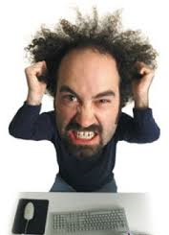
Low Hanging Fruit…..Eliminate repetitive cases
According to 2018 AMC SI reports, 11% of “fallers” accounted for 25% of all inpatient falls
For the first 231 falls in 2019, 21 patients fell 51 times and account for 22% of all falls
One patient fell 11 times on 7 different units in 2018….AND has fallen 5 more times on 5 different units in 2019

Slide 20
What to do about it?
Education provided to staff in recent falls fair
Deepen Manager Reviews
Correct SI scores
Review each fall for Soarian post-fall assessment completion
Report 5 why’s countermeasures in huddle
Work with clinical IS to more easily identify patients with previous inpatient fall histories on admission

Slide 21
Best Practices
Address high fall risk patients in every huddle
Interactive huddle every time
Use patient fall agreement to inform all appropriate patients of their risk on admission
Robust bedside report and hourly rounds
Standardize use of bed and chair alarms
Use of unit-based falls committee for auditing
Regular attendance at SPH meeting (every 4th Thursday 1-2:30 pm in Hyuck)
Use of standardized language to indicate that staff is busy toileting patients
Not all units using badges and zone phones (can’t “see” where staff are to re-deploy)

Slide 22
What’s new?
Separation of Falls Prevention and Safe Patient Handling Efforts
Originally joined due to overlapping concerns and the state mandate to form a Safe Patient Handling Committee in January of 2017
Safe Patient Handling is an initiative to increase patient safety and prevent staff injury related to the movement of patients
There is an increasing need to address the safety of our staff in all its forms and to increase staff situational awareness regarding their workplace safety and our efforts to address these needs organizationally

Slide 23

Nurse Managers
It will be an expectation going forward that if there is a fall with any injury (a harm score of 5 and above) on your unit, that you will attend and present that fall at the Falls/SPH meeting.
Remember: 4th Thursday of each month in Huyck! 1 to 2pm-falls
2pm to 230 for SPH

Slide 24

…the Right kind of Data

Slide 25
SI Reporting
Move to reporting falls with harm at the Friday safety huddle
This will provide time to ensure that reports are reviewed and properly scored

Slide 26
SI-Scoring (continued)
Reaches the Patient
  3-No harm Evident-the patient falls, reaches the ground (assisted or unassisted), no injury to the patient is evident and no additional treatment, testing or monitoring is required
  4-Emotional or Physical Distress/Inconvenience-Patient falls, any tests or scans done show no injuries. No additional treatment and/or LOS is required
  5-Additional Treatment-Minor injury to the patient resulting in minor additional treatment such as bruise, abrasion, steri-strips, splinting, muscle/joint strain

Slide 27
Harm
Harm-causing significant bodily or psychological injury or disfigurement that interferes significantly with functional ability or quality of life
6-Temporary harm-a patient sustains injuries that will likely lengthen length of stay, require a higher level of care or care unrelated to their reason for admission. May result in surgery, casting, traction, medical consultations for neurological or internal injuries or patients with coagulopathy who receive blood products as a result of the fall. The patient is expected to completely recover from their fall related injury.
7-Permanent Harm-the same as above but the patient is expected to have lingering deficits such as limited or challenged mobility.
8-Severe Permanent Harm-the same as above with severe, permanent deficits in functioning, i.e., wheelchair bound, TBI
9-Death

Slide 28

Questions?

Slide 29
References
Joint Commission Center for Transforming Healthcare. (2018, February). Facts About the Preventing Falls Project. Retrieved from https://www.centerfortransforminghealthcare.org/assets/4/6/CTH_Prev_Falls_Fact_Sheet082316.pdf
Dykes, C. D. (2017, August). Pilot testing TIPS(tailoring interventions for patient safety); a patient-centered fall prevention toolkit. The Joint Commission Journal on Quality and Patient Safety, 43(8), 403-413. doi:https://doi.org/10.1016/j.jcjq.2017.05.002
Dykes, P. A. (2018, September). Preventing falls in hospitalized patients. American Nurse Today, 8-13
Centers for Disease Control and Prevention. (2019, May 8). 10 Leading Causes of Non-fatal Injury in the United States. Retrieved from https://webappa.cdc.gov/sasweb/ncipc/nfilead.html: 2019
Centers for Disease Control and Prevention. (2019, May 8). Leading Causes of Death Reports. Retrieved from WISQUARS: https://webappa.cdc.gov/cgi-bin/broker.exe

